Slide 1
Java versions
a migration strategy
by Albert Attard

Slide 2
Agenda
What’s so unique to Java version migration?
What can go wrong?
A migration strategy

Slide 3

Code examples
All code examples can be downloaded from: https://bit.ly/3bBcw4g

Slide 4
What’s so unique to Java version migration?

Slide 5
1 feature

Slide 6
2 features

Slide 13
Notes:
When working using TDD, we first get a failing test, which confirms that the test runs and fails as expected. This is an important confirmation. Then we implement our solution and verify it through the test that we just wrote.
When upgrading Java, the FAIL/PASS cycle is not deployed. We run the tests and simply make sure that these all PASS. It is also important to make sure that these ran and produced the same effect.

Slide 14
What can go wrong?

Slide 15
Is Java backwards compatible?
Notes:
In general yes, but not 100% backwards compatible. For example, Java 1.5 introduced enum as a new keyword, breaking backwards compatibility
Some libraries take advantage of internal implementations of Java that were not expected to be used by others. These internal implementations change without notice, and things that depend on them will stop working.
The Java API is evolving and things change there too. Java 5 introduced the new @Deprecated annotation (https://docs.oracle.com/en/java/javase/17/docs/api/java.base/java/lang/Deprecated.html), marking APIs that should be avoided. In Java 9, this annotation was enhanced and included the forRemoval property, indicating that this entry will be removed in a future release. Deprecated entries, such as the Applet (https://openjdk.java.net/jeps/398) and the Security Manager (https://openjdk.java.net/jeps/398), are marked for deletion.
Java 9 also introduced a new encapsulation module which makes it harder for libraries to access areas that were not expected to be accessed (https://openjdk.java.net/projects/jigsaw/). These encapsulations are getting stronger with newer releases.

Slide 16
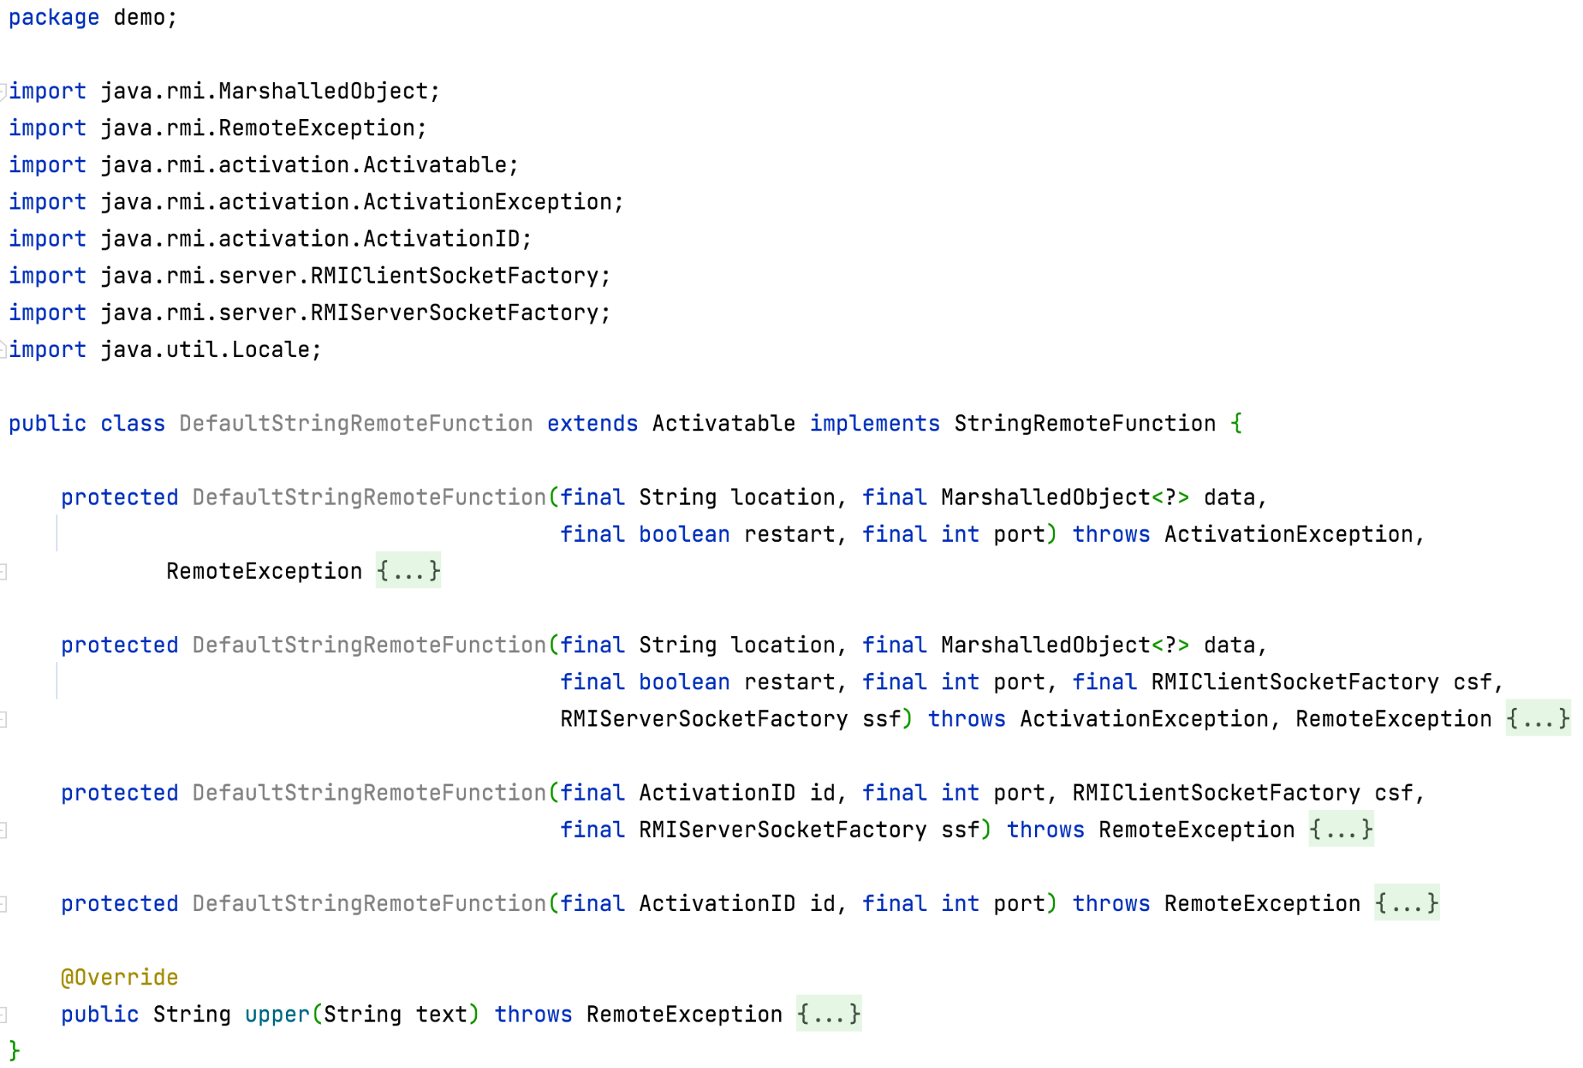
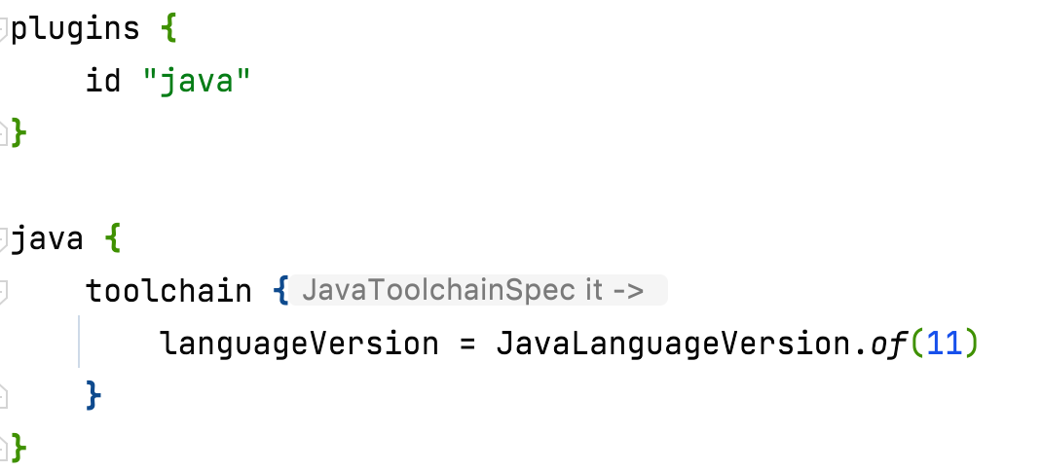
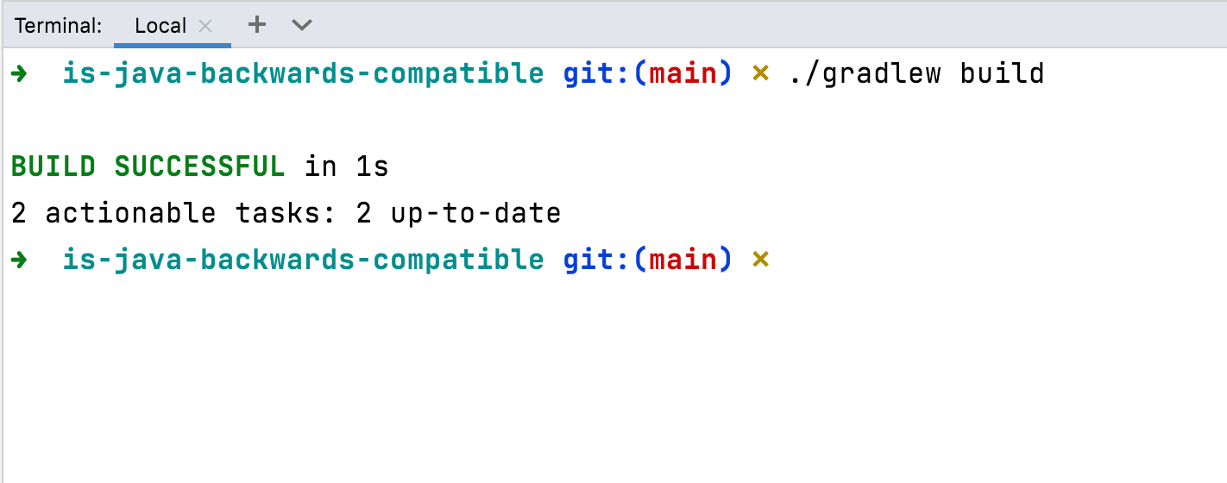

Slide 17
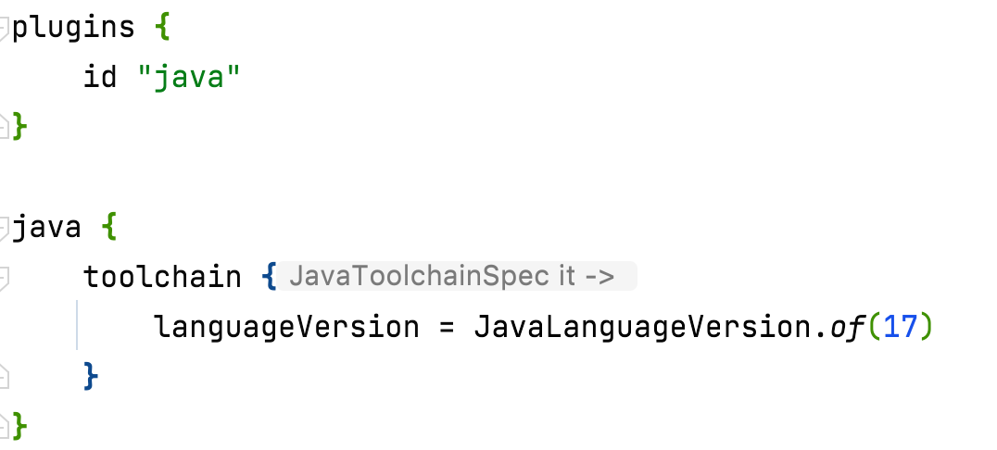
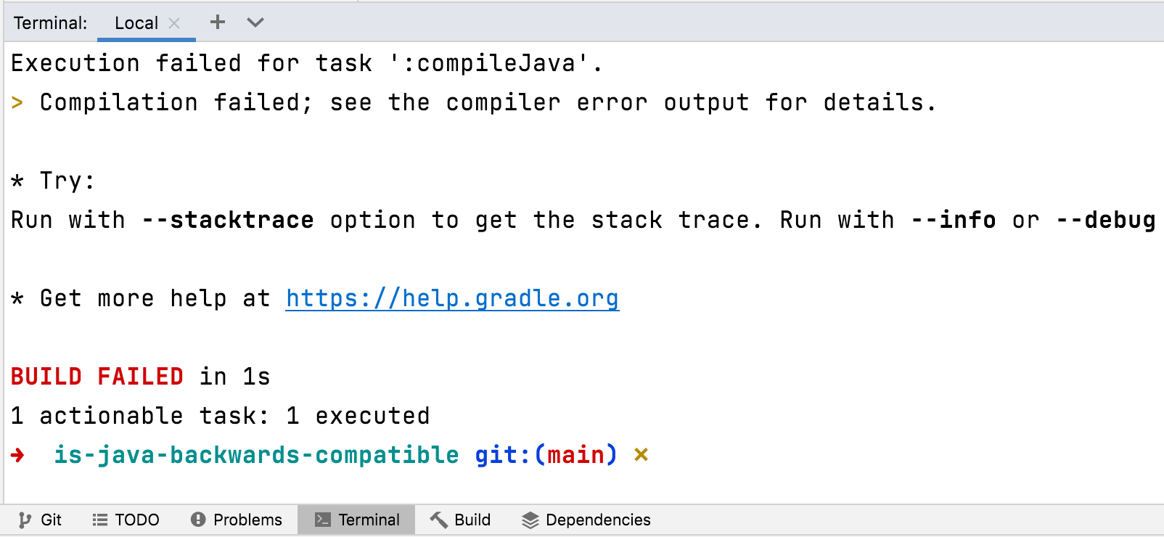
The java.rmi.activation package was removed in Java 15 as part of JEP 385
Notes:
https://openjdk.java.net/jeps/385

Slide 18
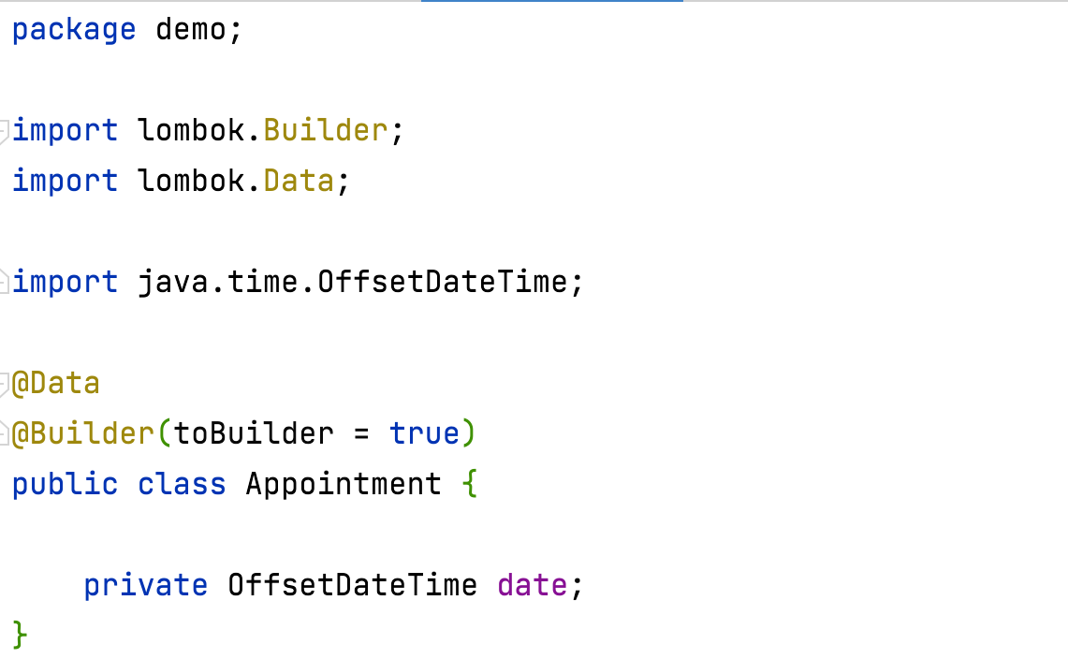
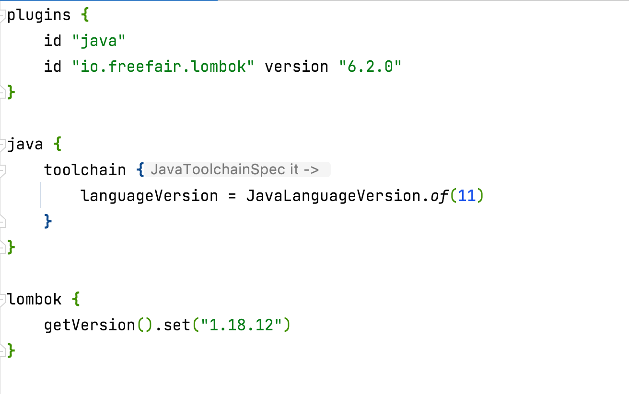
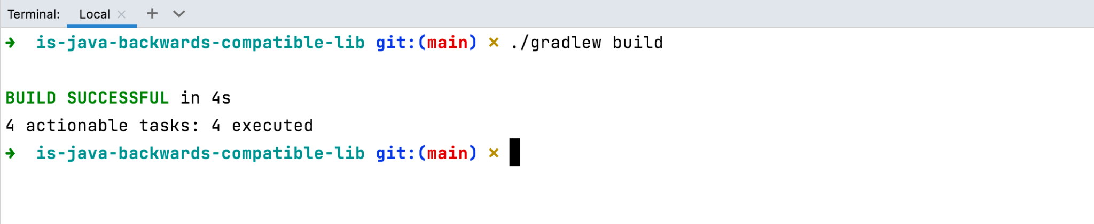

Slide 19
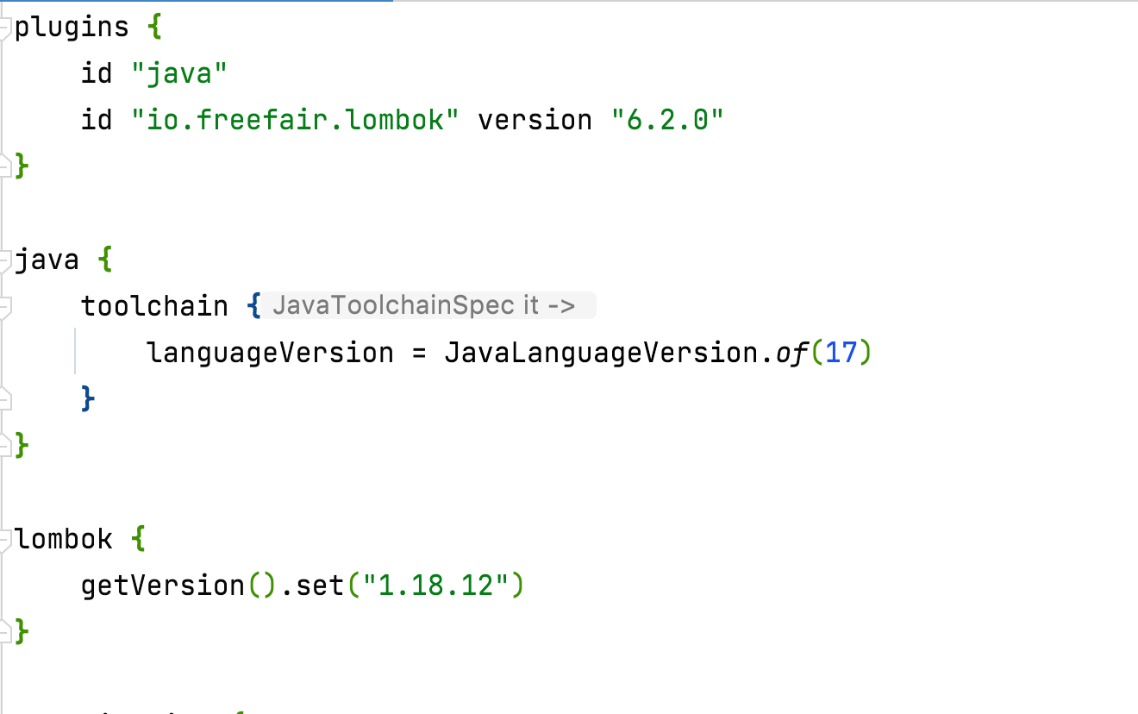
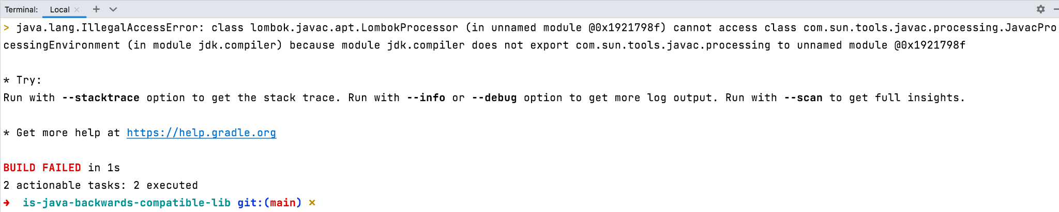
Lombok 1.18.20, and above, support Java 17
Notes:
Lombok 1.18.20 and above support Java 17

Slide 20
A newer dependency version may not play well with other dependencies
Notes:
One of the problems that Spring Boot addressed was actually this - compatibility between dependencies.
Recently we encountered an issue when updating Lombok from v1.18.12 to the latest v1.18.22 (https://projectlombok.org/changelog). The newer version of Lombok affected the way it interacts with Jackson, and a particular JSON object was not properly deserialized. The issue was related to date/time with timezone and when a format was specified in the Jackson annotation. Luckily we had tests that caught this issue at build time. Lombok added support for Java 17 in v1.18.22 (as part of https://github.com/projectlombok/lombok/issues/2898). This means that we cannot switch to Java 17 yet, before we iron out these issues.

Slide 21
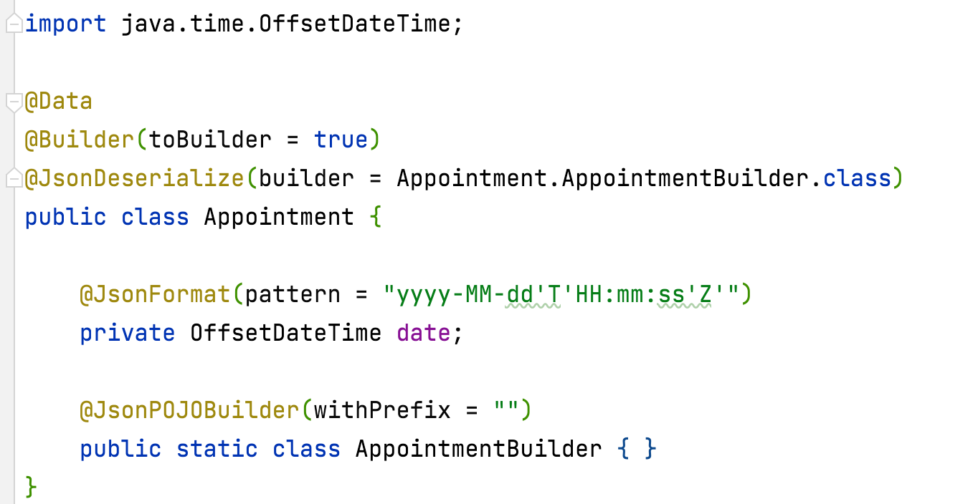
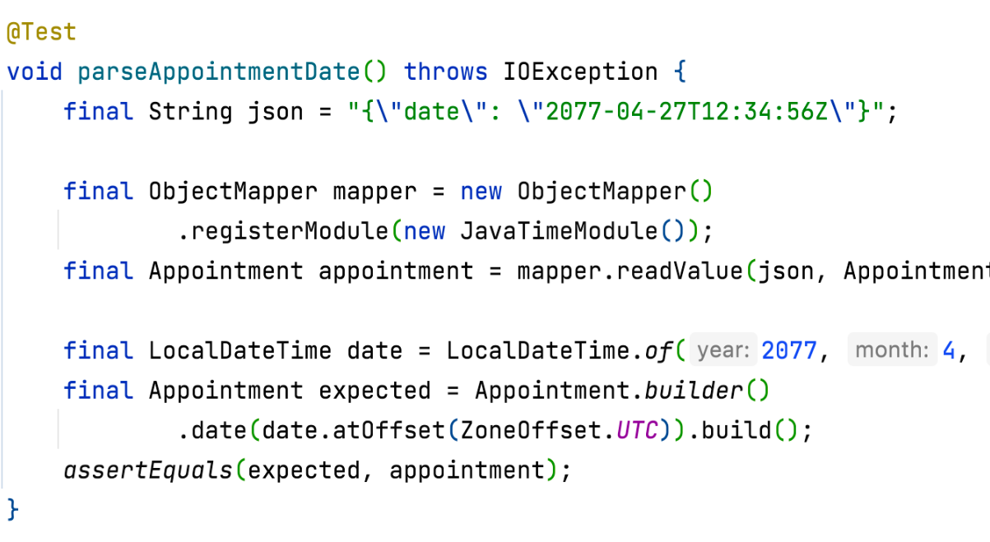
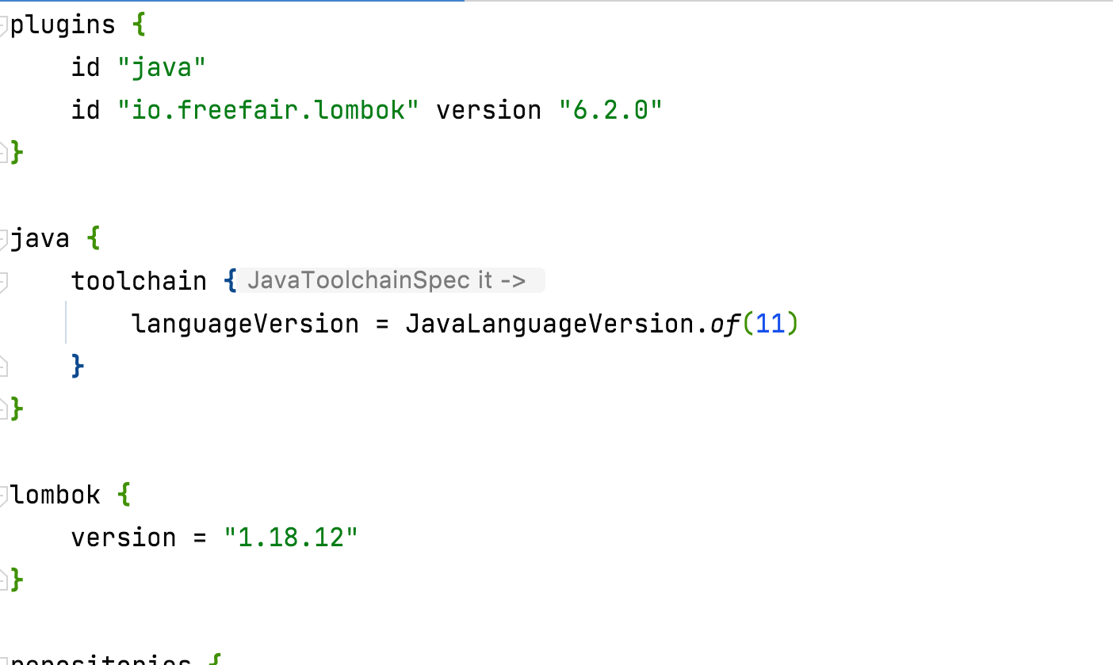
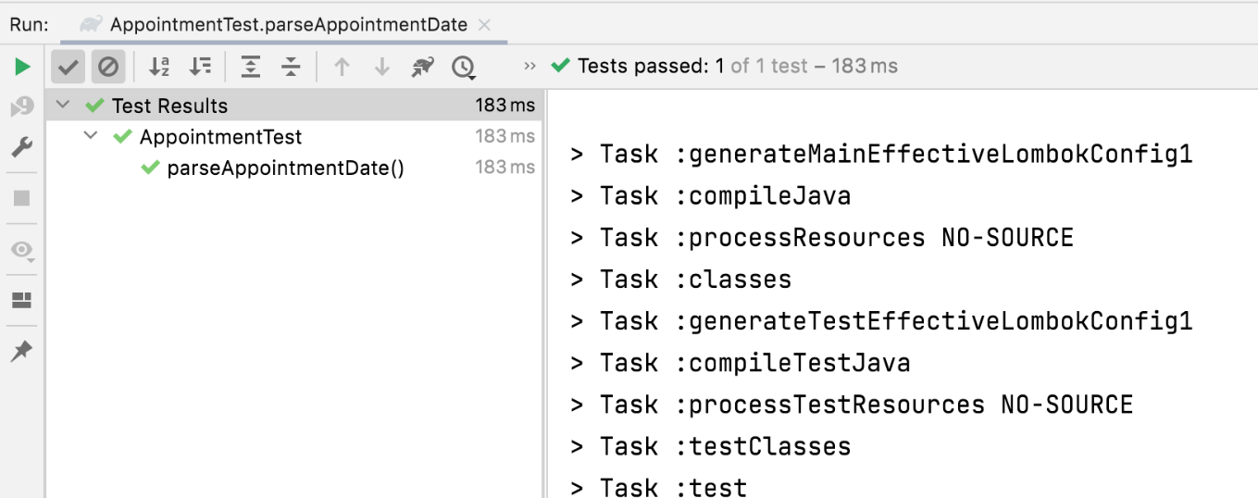


Slide 22
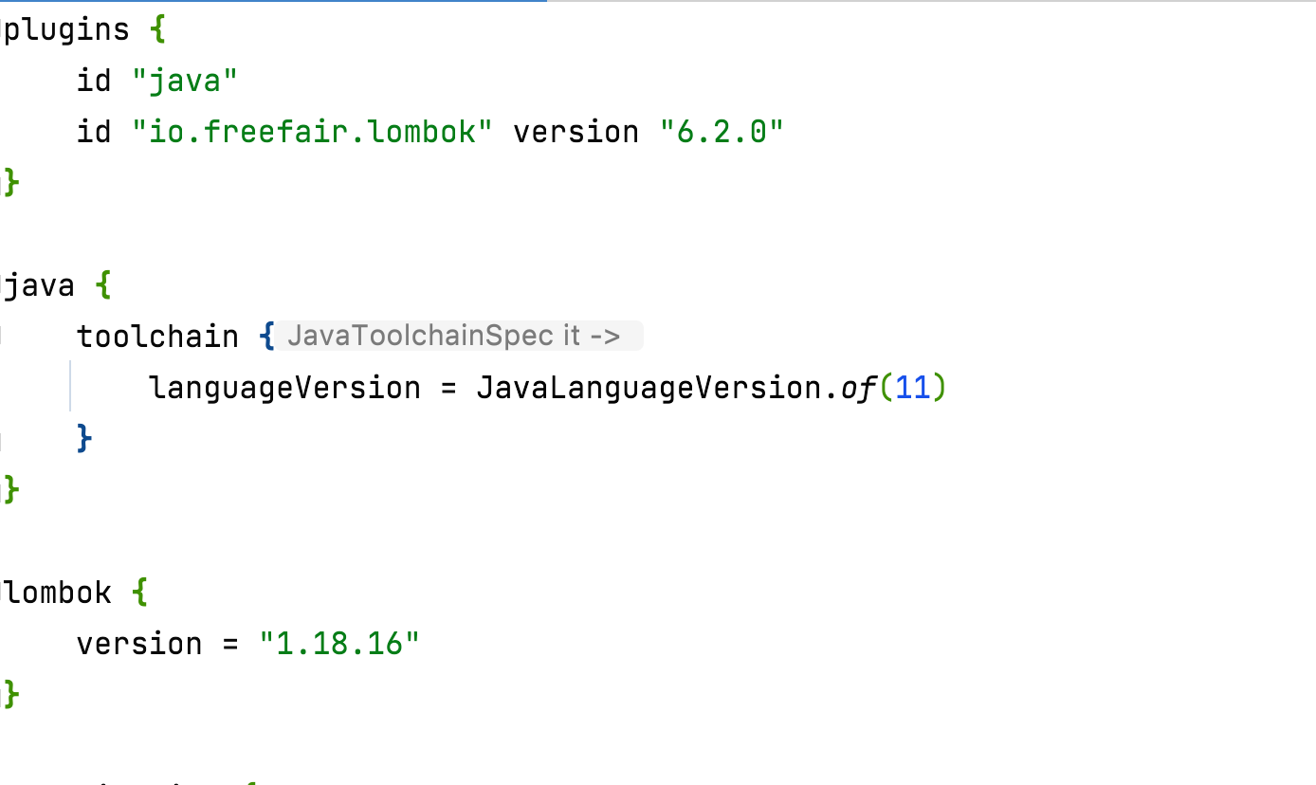
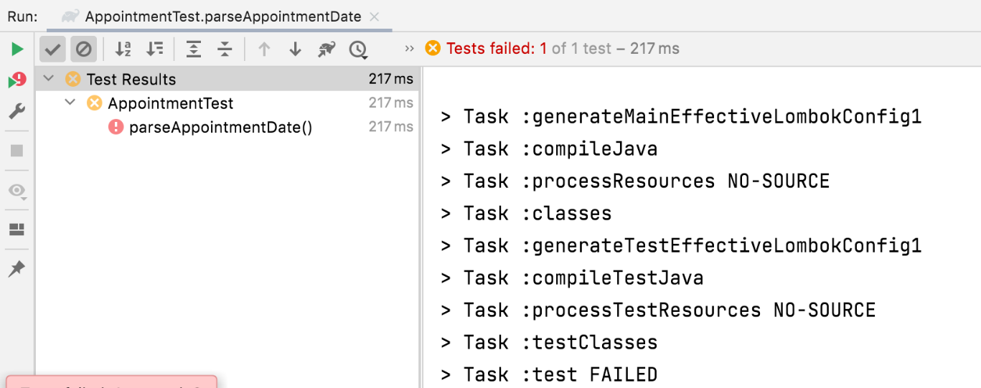


Slide 23
Gradle support for Java 17 is not yet official
Notes:
Gradle 7.1.1 does not support Java 17
Plugins working in version Gradle 6 may not work in Gradle 7
Plugin configuration may have changed between versions
How can you be certain that the tasks, such as tests, running before are still running now?

Slide 24
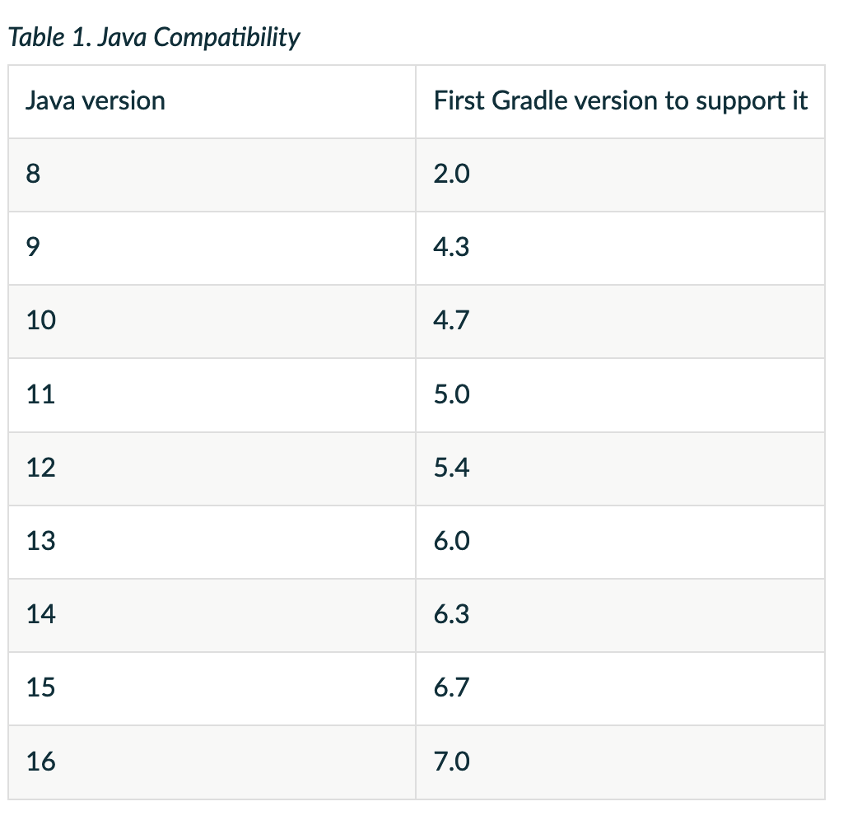
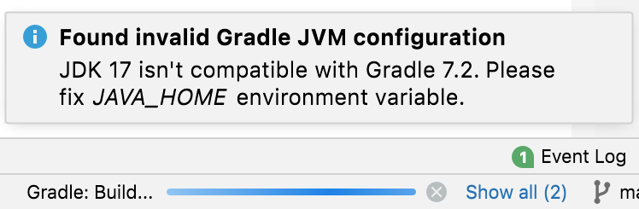
Gradle 7.2 seems to support Java 17, but this is not yet official
IntelliJ shows the following warning
Notes:
https://docs.gradle.org/current/userguide/compatibility.html

Slide 25
Are the tests really running?
Notes:
Switching from JUnit 4 to JUnit 5 may not be as trivial as you think. For example, our JUnit 5 tests were not running in the pipeline, but worked well from the IDE. The issue was related to the Maven surefire plugin version (https://github.com/junit-team/junit5/issues/1341), which was fixed in version 2.22.0.

Slide 26
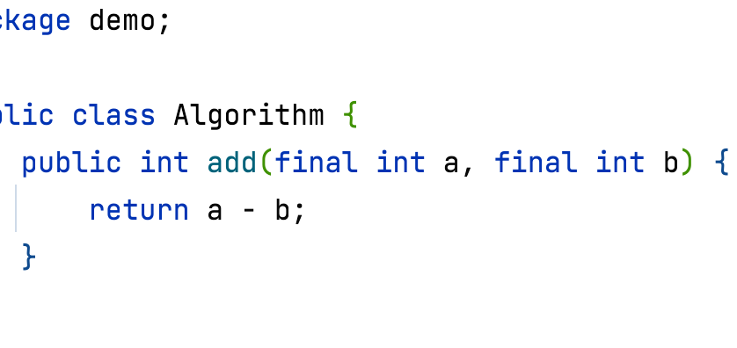
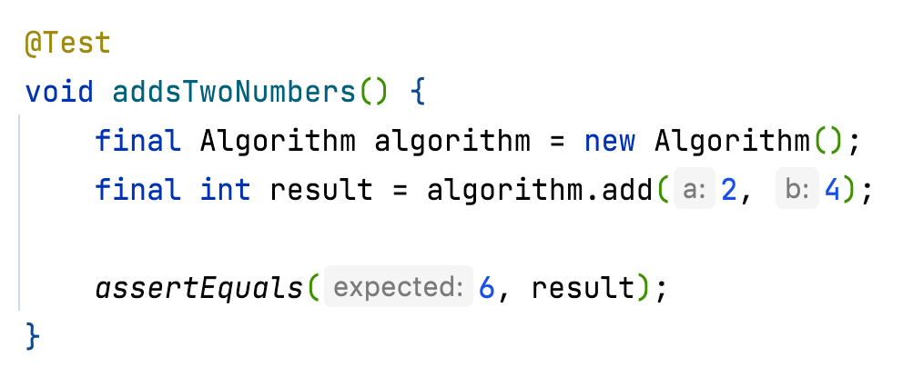
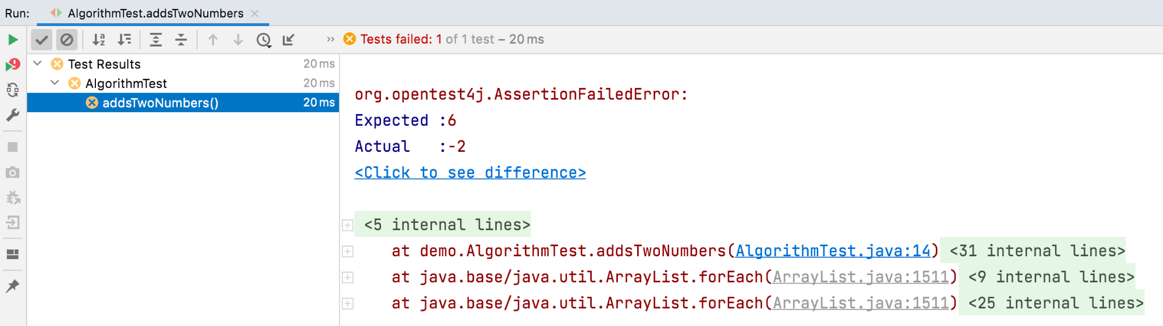
This is an intentional bug

Slide 27
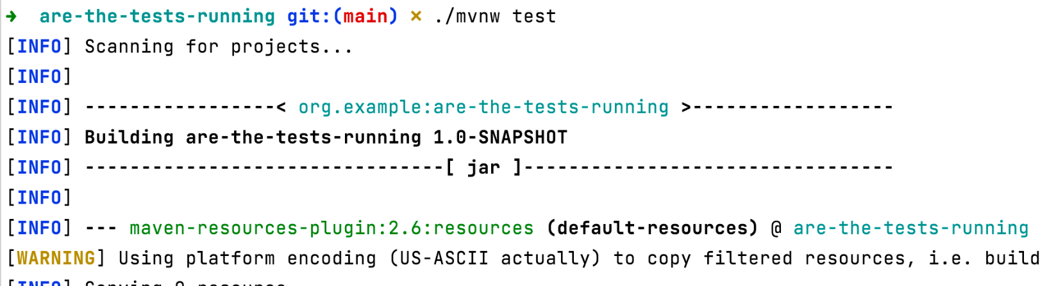
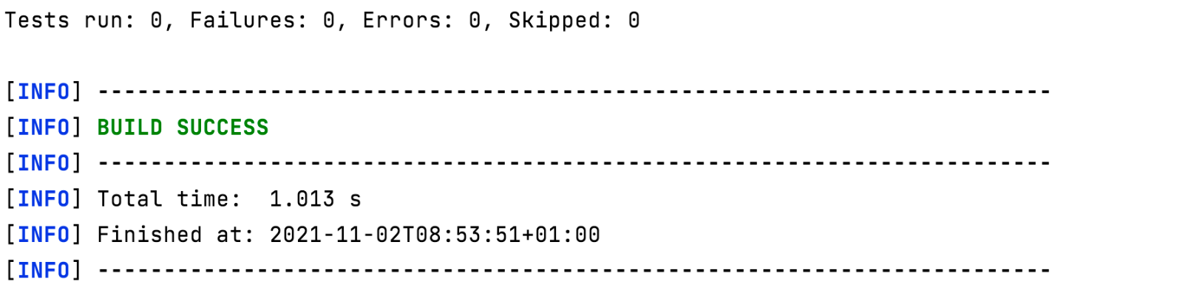

Slide 28
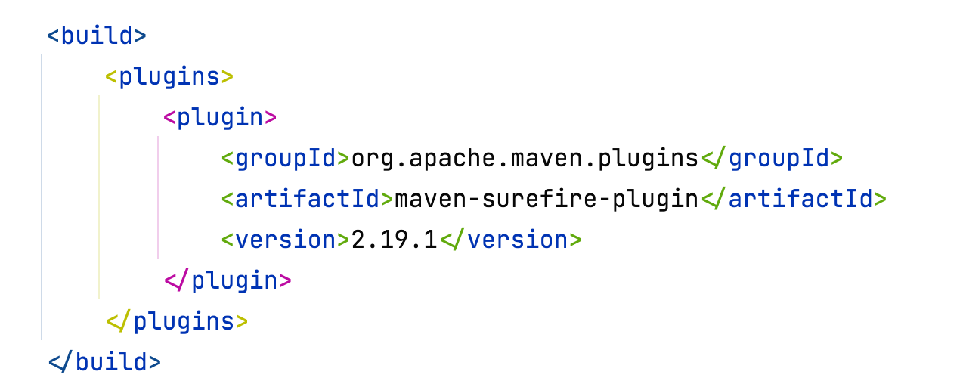
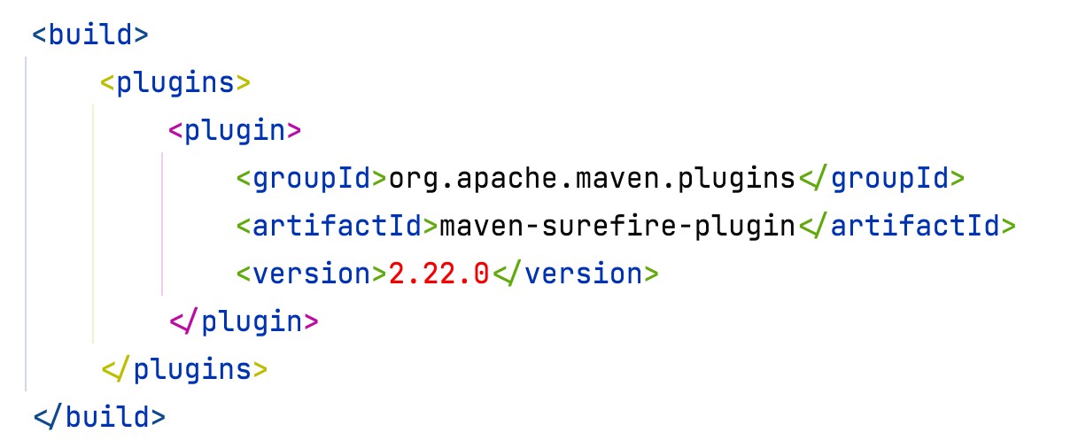
JUnit 4 tests are executed
JUnit 5 tests are NOT executed
JUnit 4 tests are executed
JUnit 5 tests are executed

Slide 29
Code coverage should not change
Notes:
One important metric is code converge
When updating the tooling, like Gradle, Sonarcube, PIT mutation testing, you don't go through the small red/green development flow that we enjoy during development. This makes it harder to measure the impact of this change on the project. One needs to be careful in managing expectations and making sure that these are met. For example, if code coverage was 88% before the update, then this should remain the same after the update and if it changes the changes are expected.

Slide 30
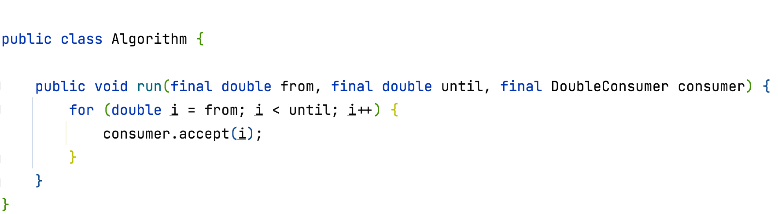
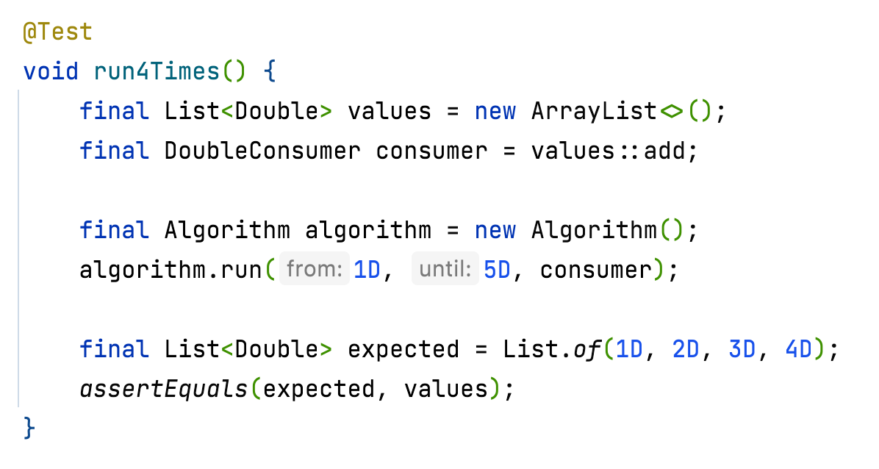
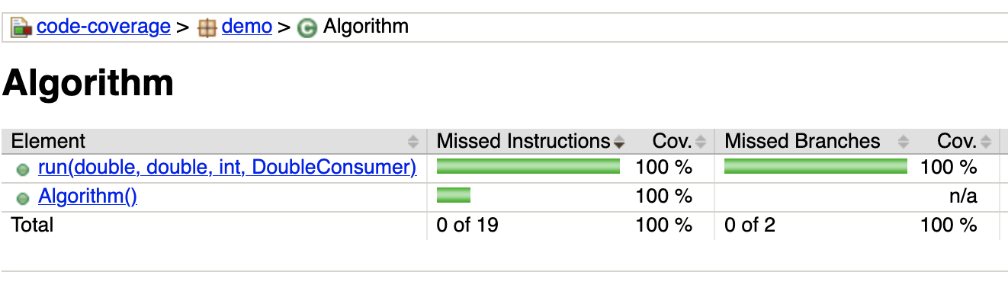
100% code coverage

Slide 31
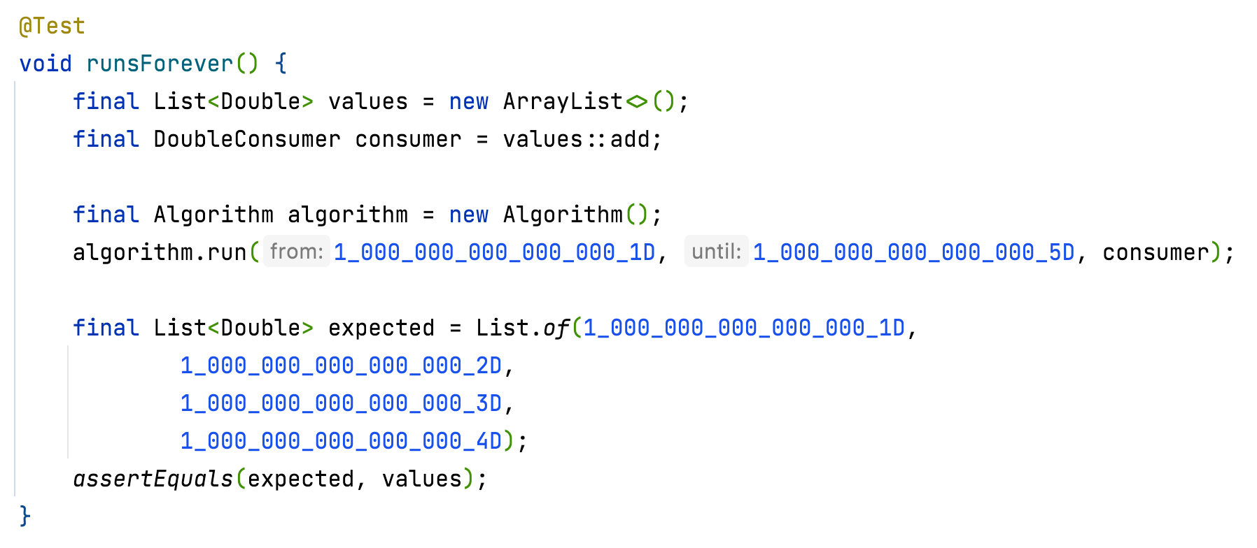
Runs forever, or until it runs out of memory

Slide 32
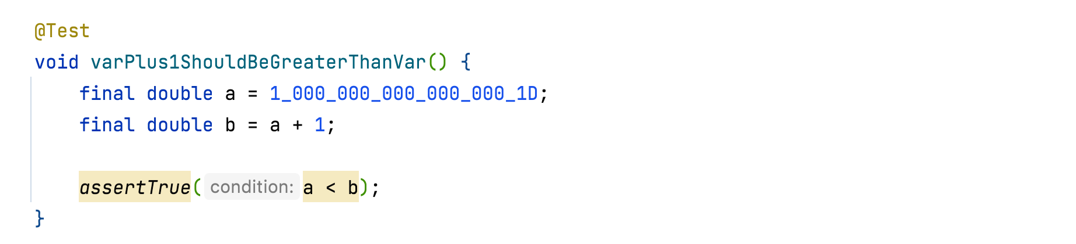
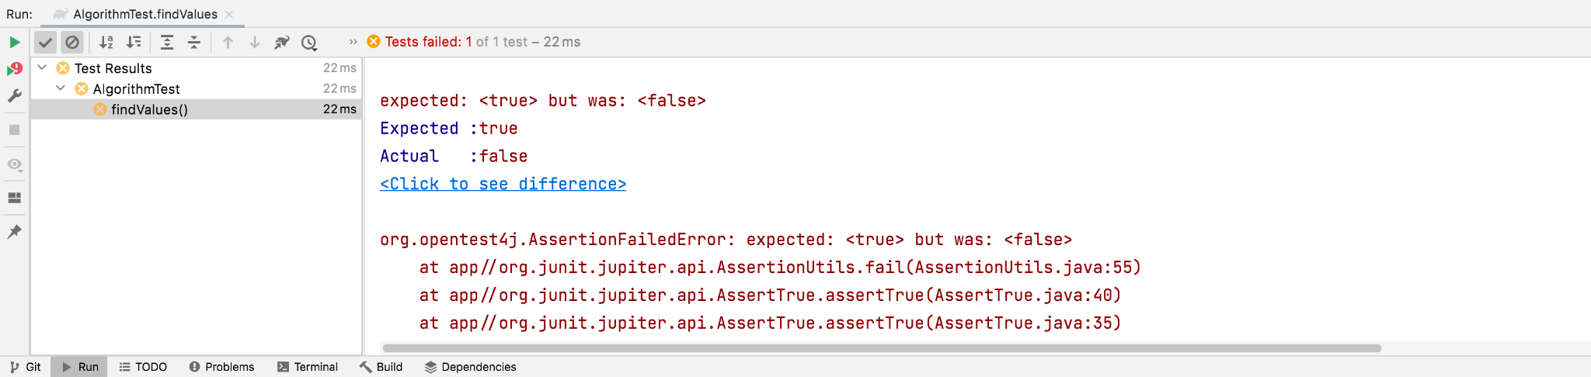
Notes:
Java Puzzlers Traps, Pitfalls, and Corner Cases
Puzzle 28: Looper
Puzzle 34: Down for the Count

Slide 33

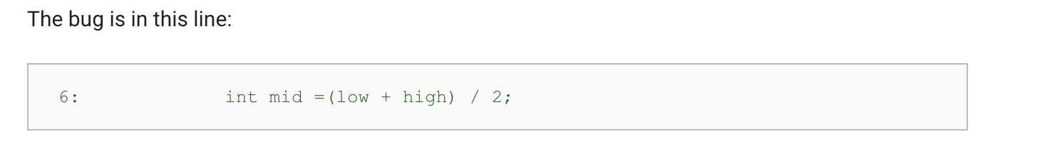
Notes:
https://ai.googleblog.com/2006/06/extra-extra-read-all-about-it-nearly.html

Slide 34
As fast to update as your slowest dependency
Notes:
Furthermore, not all tooling supports the latest versions of Java and some take time to adopt. Records were released as part of Java 16 on March 16, 2021 (https://openjdk.java.net/jeps/395). PIT mutation testing, was not ignoring the method generated by the compiler and was showing low coverage just because of that. This was addressed in version 1.6.9 (https://github.com/hcoles/pitest/pull/919), released on August 12, 2021 (https://github.com/hcoles/pitest/releases/tag/1.6.9).

Slide 35
A migration strategy

Slide 36






Image from: https://www.britannica.com/technology/assembly-line
Notes:
Image from: https://www.britannica.com/technology/assembly-line

Slide 37
Java 8
Development
Unit and Integration Tests
Functional Tests
Production

Slide 38
Java 8
Source code
Bytecode
Development
Unit and Integration Tests
Functional Tests
Production

Slide 39
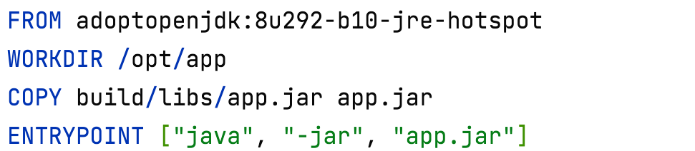
The functional tests run against the container

Slide 40
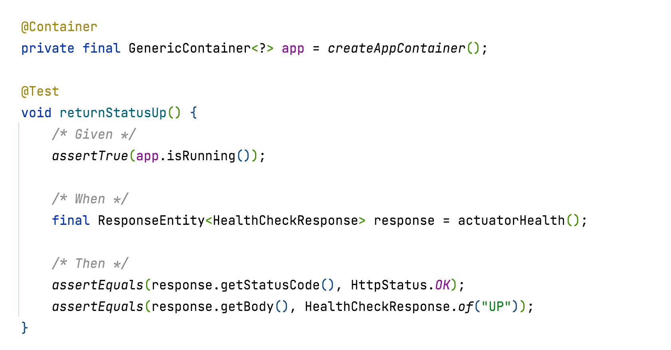
Notes:
The functional test is not part of the application and can be in any programming language we want. We have two independent code-bases
app
functional-test
In this example we used Java and Testcontainers (https://www.testcontainers.org/)

Slide 41
Java 8
Java 11
Development
Unit and Integration Tests
Functional Tests
Production

Slide 42
Java 8
Java 11
Development
Unit and Integration Tests
Functional Tests
Production
Functional Tests
Notes:
We do not change the current pipeline and simply add a new one. We do deploy to production even if the new functional tests fail.
We stay in this stage until all tests (Java 8 unit/integration+functional tests and Java 11 functional tests). Any changes made need to work with both versions.

Slide 43
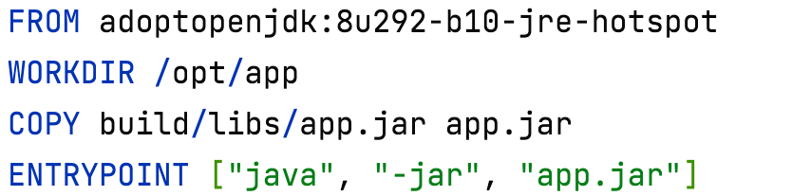
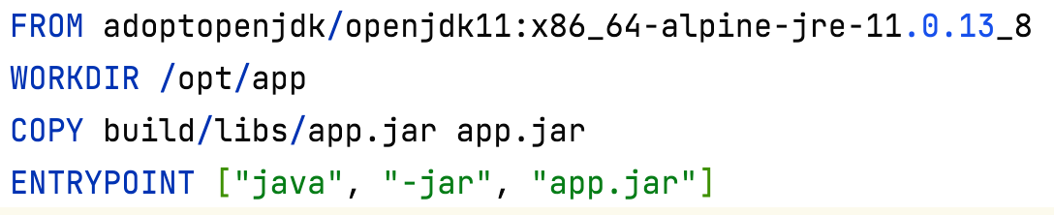

Slide 44
Java 8
Java 11
Development
Unit and Integration Tests
Functional Tests
Production
Unit and Integration Tests
Functional Tests
Notes:
We do deploy to production even if the new unit/integration tests fail.
We stay in this stage until all tests (Java 8 unit/integration+functional tests and Java 11 unit/integration+functional tests). Any changes made need to work with both versions.

Slide 45
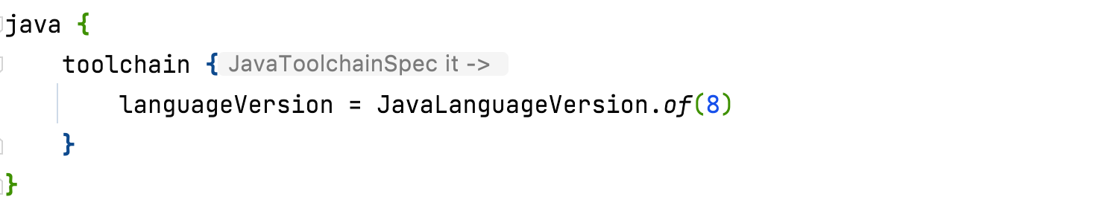
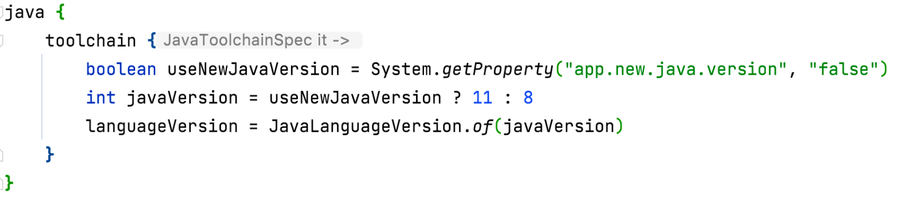
./gradlew build -Dapp.new.java.version=true
Notes:
It is important to push this change alone and not with other code changes. You need to make sure that the Java 8 pipeline works as expected.
Instead if using toolchain, we can rely on the version installed on the host.

Slide 46
Java 8
Java 11
Development
Unit and Integration Tests
Functional Tests
Production
Unit and Integration Tests
Functional Tests
Notes:
Only push to production, if both path succeed. The Java 8 image should be created and readily available.

Slide 47
Java 8
Java 11
Development
Unit and Integration Tests
Functional Tests
Production
Notes:
Note that up to now, the development environment is still in Java 8. The code compiles and passes all tests with both Java 8 and Java 11

Slide 48
Java 11
Development
Unit and Integration Tests
Functional Tests
Production

Slide 49
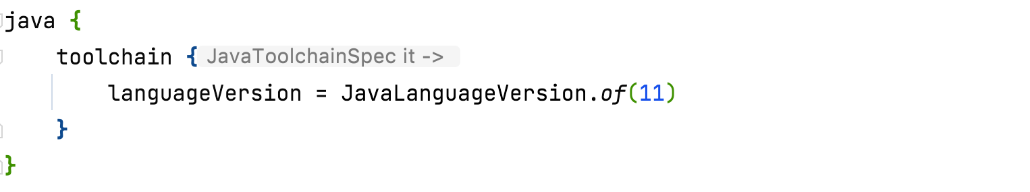
No need to have this parameterized, once the whole pipeline is switched to the same version of Java
Notes:
Once ready, we can rinse and repeat

Slide 50
Thank you
Albert Attard
albert.attard@thoughtworks.com

